Slide 1
Models of the motor system
Spring 2025
Lecture 2: Muscles and Muscle Models
Opher Donchin

Slide 2
Muscles and Muscle Models
What turns neural commands into movements?
How do we model muscle activation and force?
What are the limitations and simplifications in muscle modeling?

Slide 3
Muscles and Muscle Models
From Neurons to EMG
From EMG to Muscle Activation
From Activation to Force
Tendons and Pennation
The Hill-Type Muscle Model
From Muscle Force to Movement

Slide 4
Part 1
From Neurons to EMG:
How does the brain send signals to the muscles?
What is EMG and what does it measure?
What can EMG tell us and what can’t it?

Slide 5
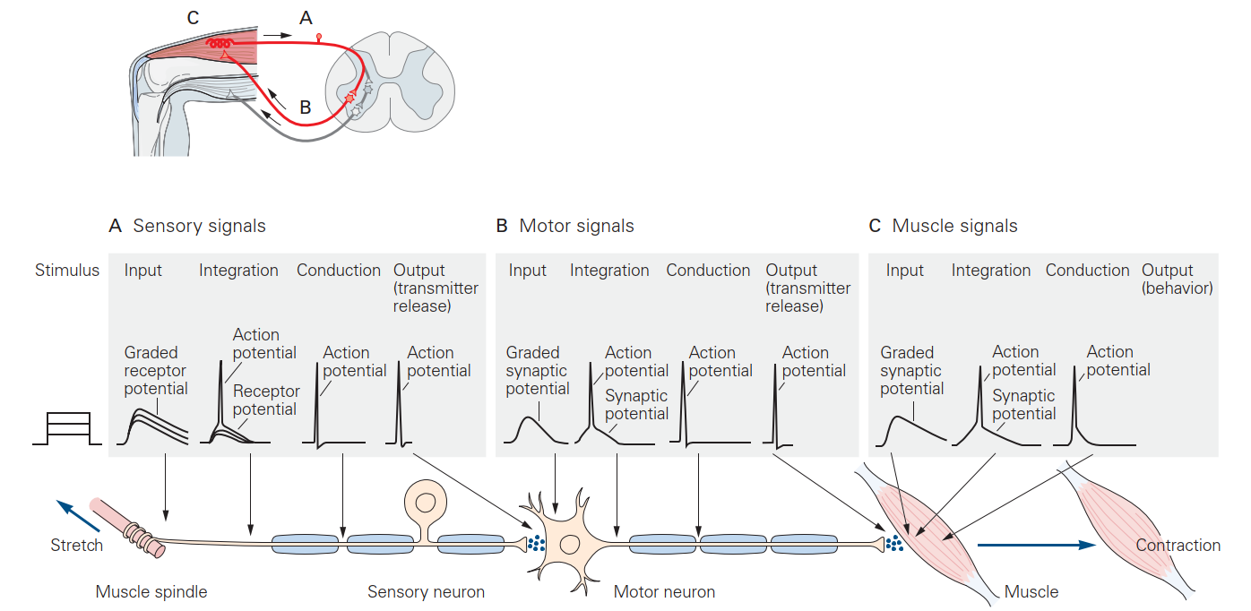
Action potentials along the loop
Dendritic potentials lead to action potentials which travel down the axons

Slide 6
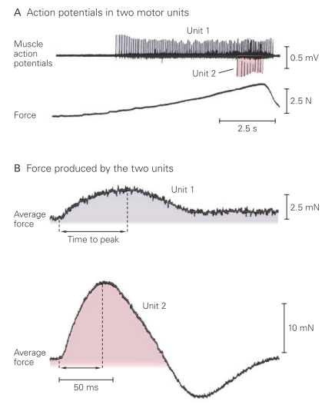
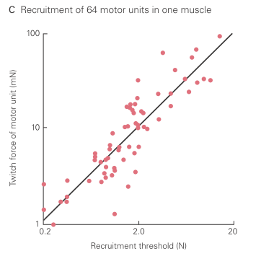
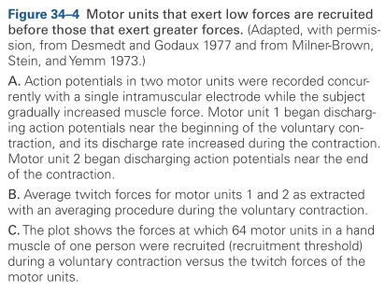
Muscle action potentials accumulate to create force

Slide 7
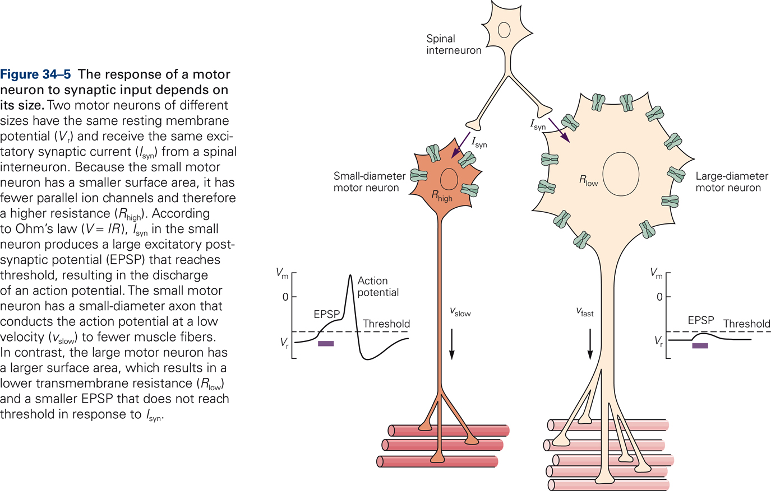
The size principle: smaller neurons fire first
Small neurons have lower thresholds
So they fire first

Slide 8
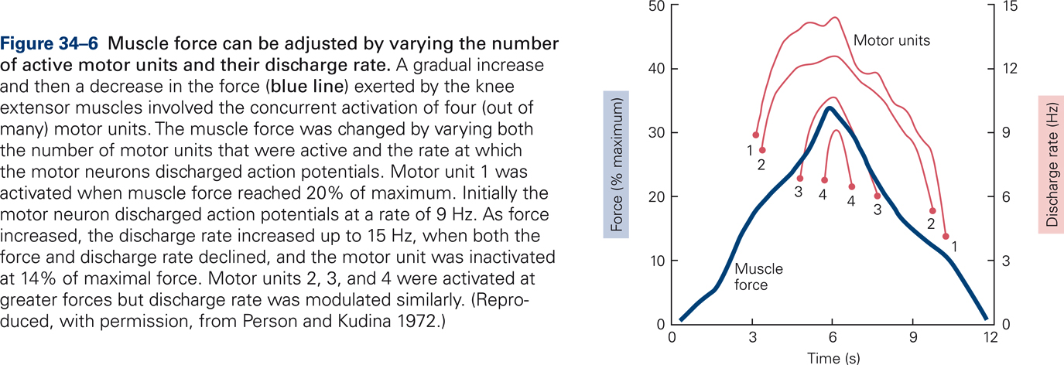
The size principle: smaller neurons fire first
Small neurons have lower thresholds
So they fire first
Larger neurons added as force demand increases
Smoother increase in force
Foundation for modeling graded muscle activation

Slide 9
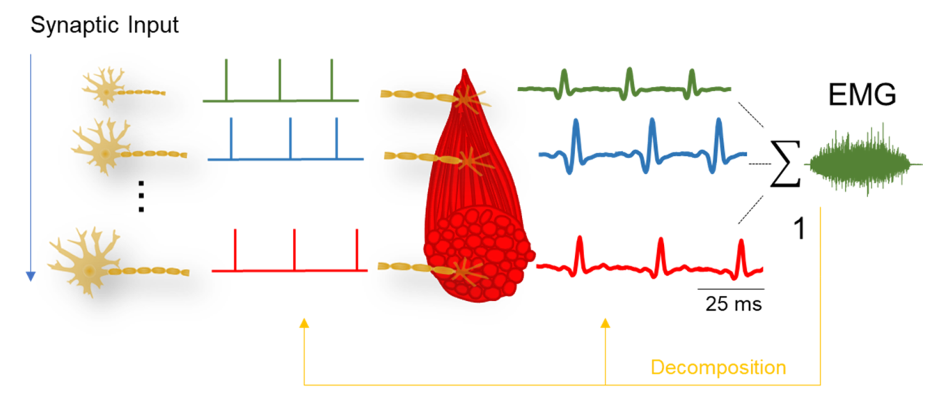
Record muscle activity with EMG
Del Vecchio J Electromy Kinesio 2020 doi:10.1016/j.jelekin.2020.102426

Slide 10
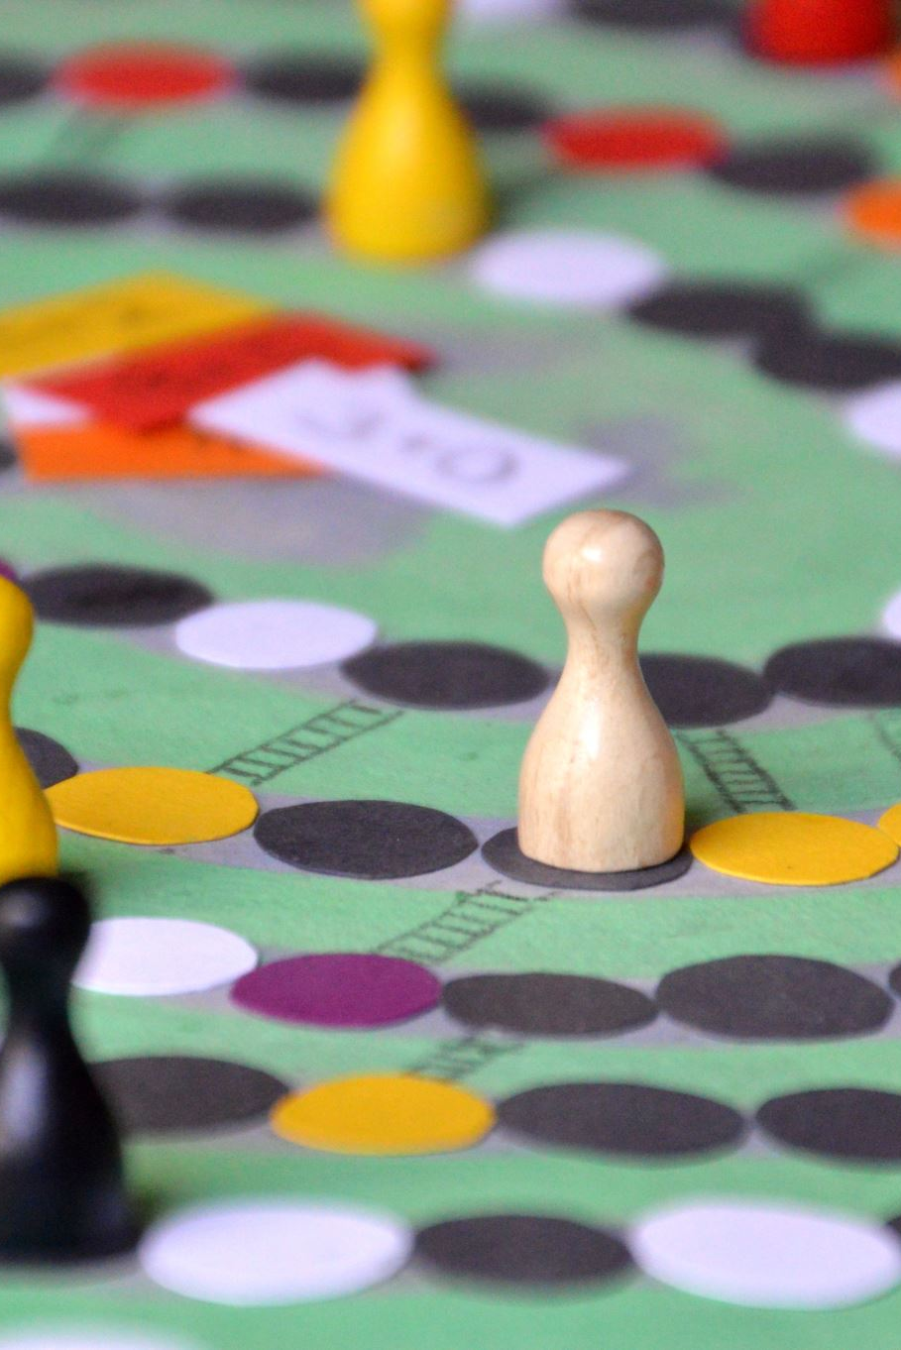
It's Kahoot Time!
Gather your devices and get ready!
Let's see who’s on top of the material!
Notes:
This slide signals the transition to the Kahoot quiz. Encourage participants to grab their devices and prepare to join the quiz. Highlight the excitement of competition, and remind them that there are fun prizes to be won. Create an engaging atmosphere as everyone gets ready to show their knowledge!

Slide 11
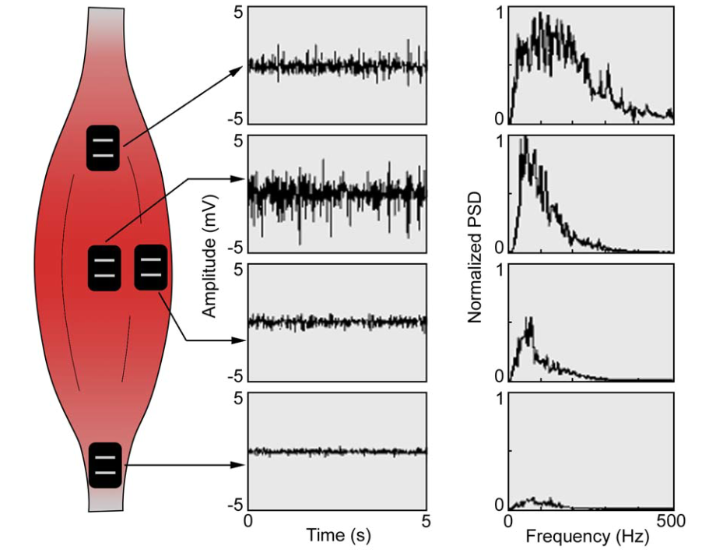
Arbitrariness of the EMG
De Luca J Applied Biomech 1997 doi:10.1123/jab.13.2.135

Slide 12
Part 2
Translating EMG activity to muscle activation

Slide 13
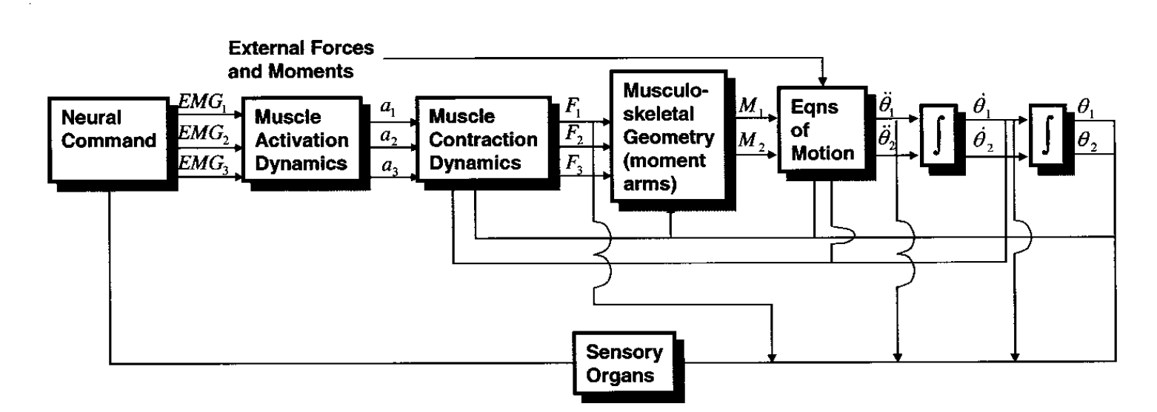
Forward model of the motor system
Buchanan J Appl Biomechanics 2004 doi:10.1123/jab.20.4.367

Slide 14
Why translating EMG to activation is hard
EMG is noisy and indirect
Estimate muscle activation
Requires assumptions
Output force depends on muscle state
Not just activation

Slide 15
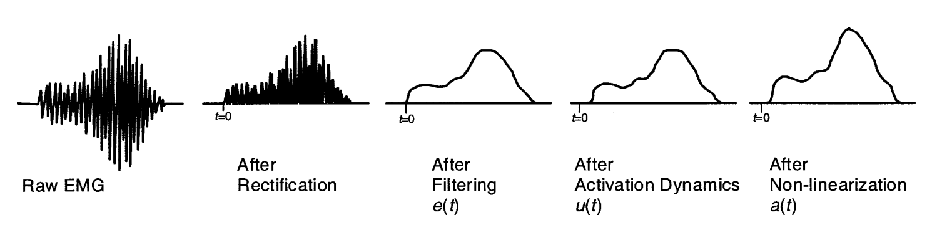
Step 1: rectify the EMG
Buchanan J Appl Biomechanics 2004 doi:10.1123/jab.20.4.367

Slide 16
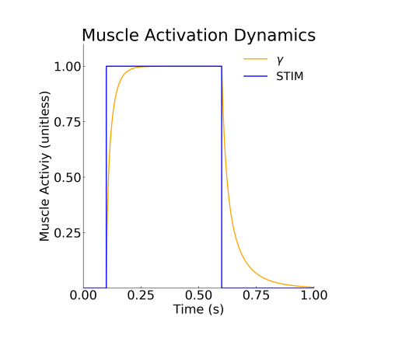
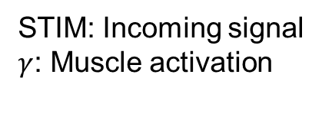
Thelen Model of activation dynamics
STIM: Incoming signal
$γ$: Muscle activation
Muscle activation modeled as first-order low-pass filter
Thelen J Biomech Eng 2003 doi:10.1115/1.1531112

Slide 17
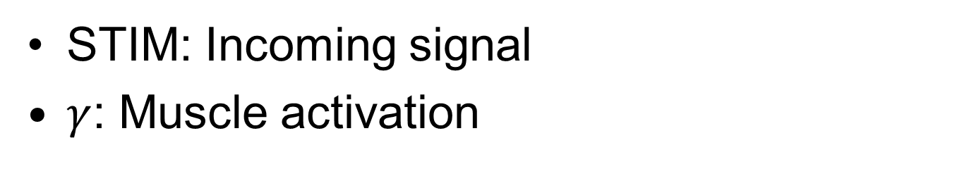
Time constant is not constant
STIM: Incoming signal
$γ$: Muscle activation
Thelen J Biomech Eng 2003 doi:10.1115/1.1531112

Slide 18
It's Kahoot Time!
Gather your devices and get ready!
Let's see who’s on top of the material!
Notes:
This slide signals the transition to the Kahoot quiz. Encourage participants to grab their devices and prepare to join the quiz. Highlight the excitement of competition, and remind them that there are fun prizes to be won. Create an engaging atmosphere as everyone gets ready to show their knowledge!

Slide 19
Step 2: apply activation dynamics
Buchanan J Appl Biomechanics 2004 doi:10.1123/jab.20.4.367

Slide 20
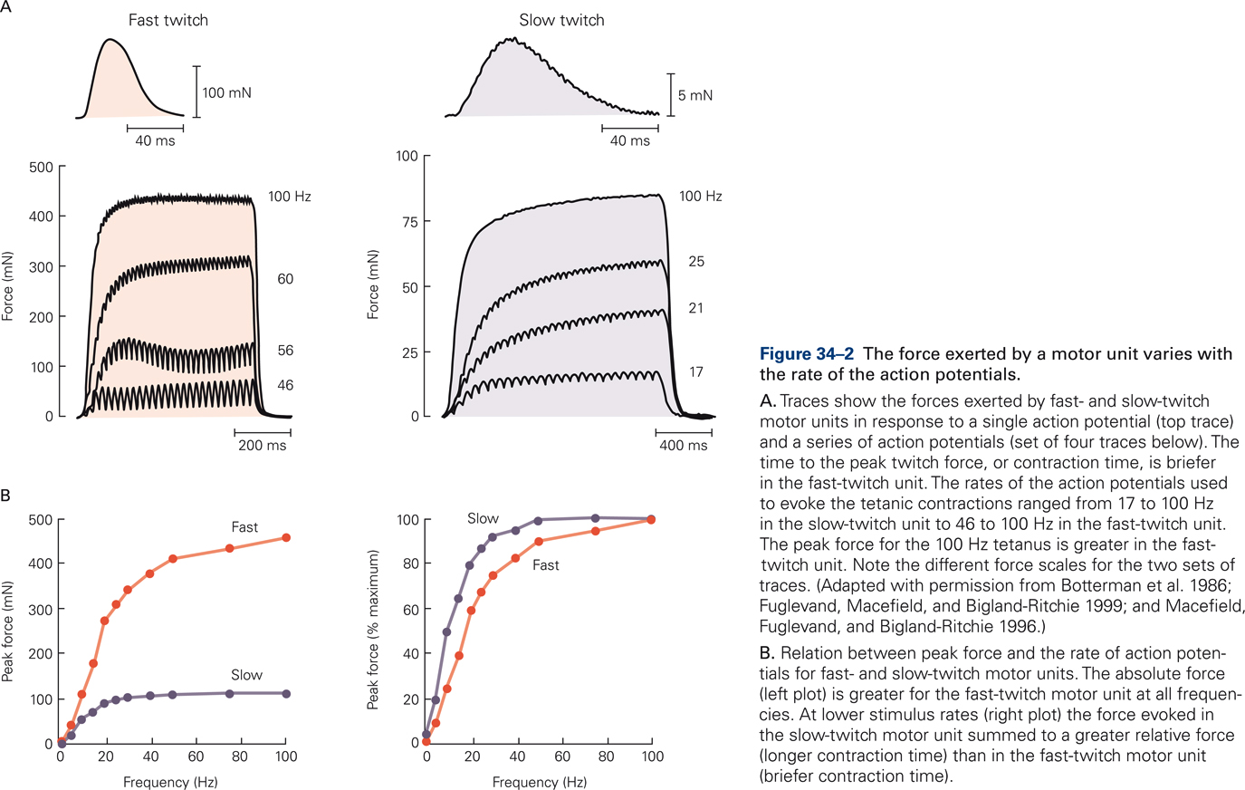
Muscle force is non-linear with activation

Slide 21
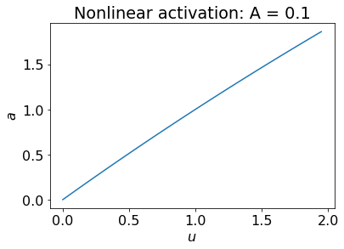
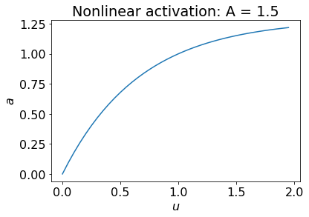
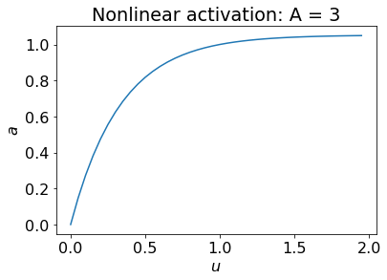
Step 3: apply non-linearity
Buchanan J Appl Biomechanics 2004 doi:10.1123/jab.20.4.367

Slide 22
Part 3
Activation creates force

Slide 23
Forward model of the motor system
Model how the activation becomes force
Buchanan J Appl Biomechanics 2004 doi:10.1123/jab.20.4.367

Slide 24
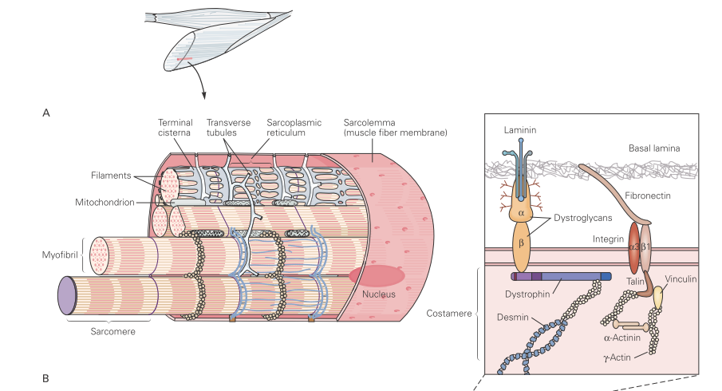
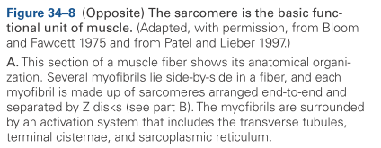
Muscle anatomy 1: sarcomeres in the muscle

Slide 25
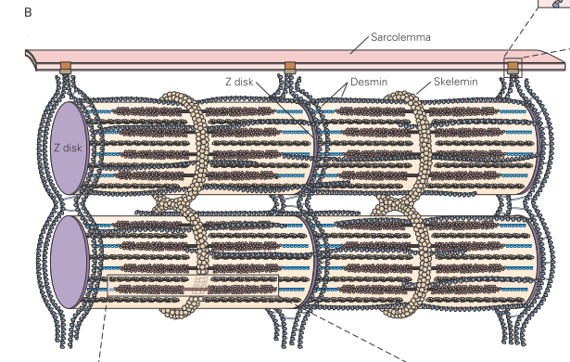
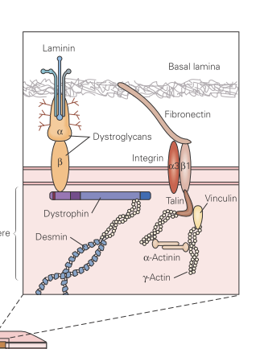

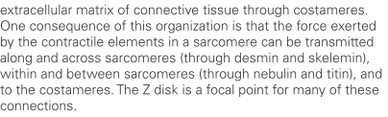

Anatomy 2: fibers in the sarcomere

Slide 26
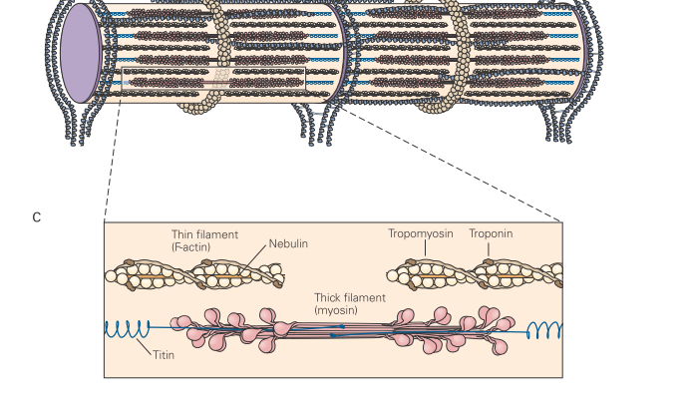
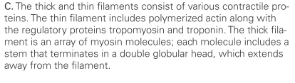
Anatomy 3: sliding filaments in the fiber

Slide 27
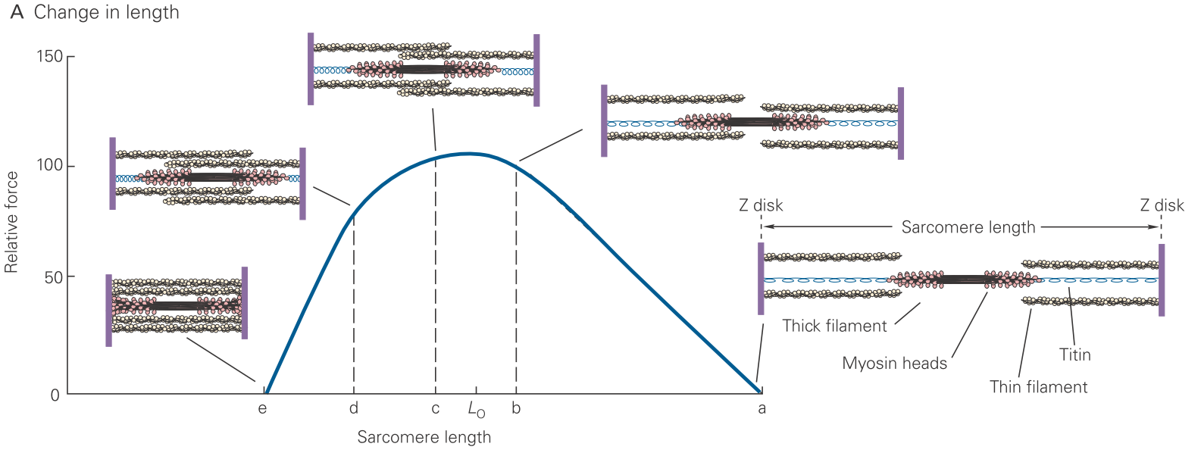
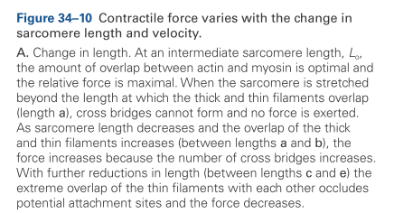
The active force-length relationship
Force depends on muscle length
Max force at optimal length
Modeled by empirical fitting
Splines and Gaussians

Slide 28
It's Kahoot Time!
Gather your devices and get ready!
Let's see who’s on top of the material!
Notes:
This slide signals the transition to the Kahoot quiz. Encourage participants to grab their devices and prepare to join the quiz. Highlight the excitement of competition, and remind them that there are fun prizes to be won. Create an engaging atmosphere as everyone gets ready to show their knowledge!

Slide 29
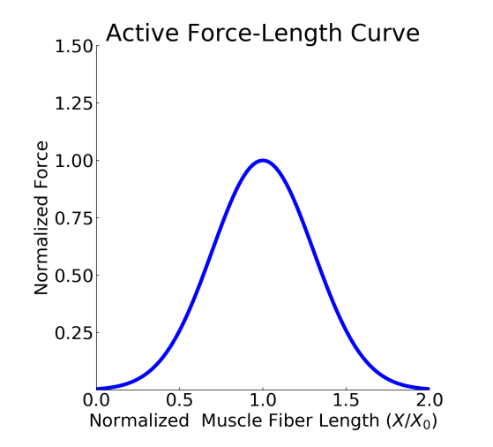
Gaussian model of active force-length curve
Force = activation * force-length curve
Thelen J Biomech Eng 2003 doi:10.1115/1.1531112

Slide 30
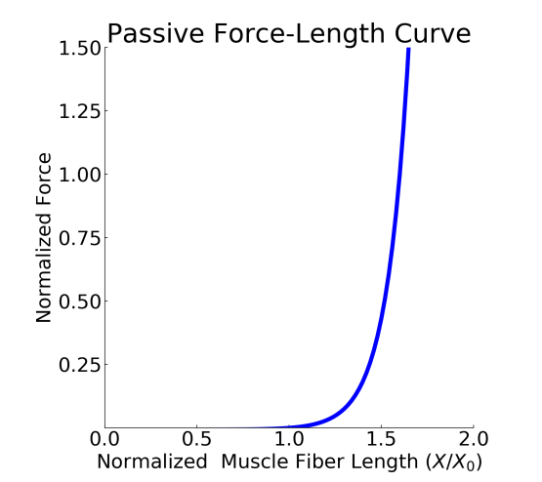
The passive force-length relationship
This is called “stretching”
Muscle reaches maximum “active” force at 1.6 times resting length

Slide 31
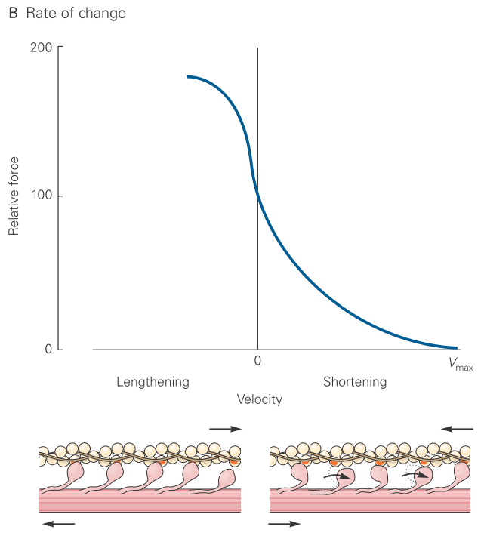

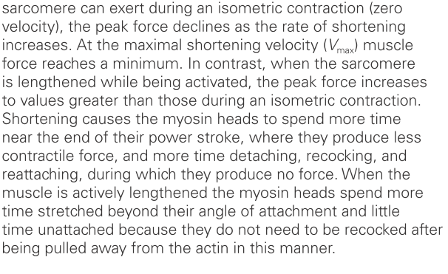
Force-velocity relationship

Slide 32
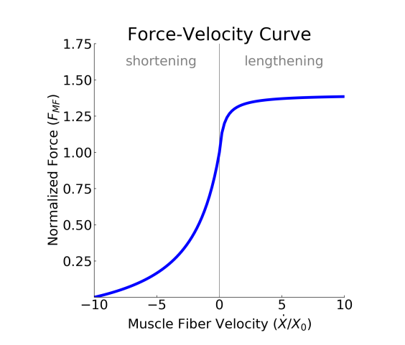
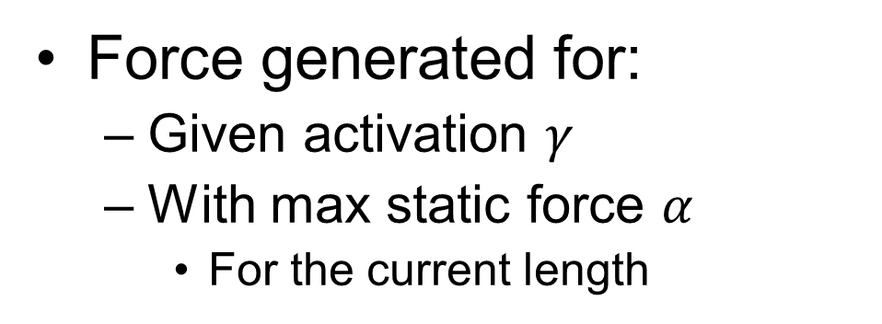
Force-velocity model
Force generated for:
Given activation $γ$
With max static force $α$
For the current length

Slide 33
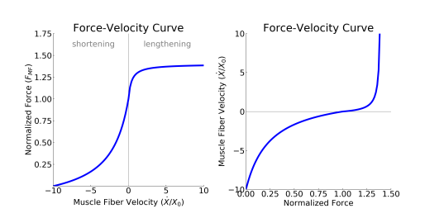
Force-velocity can be transformed to velocity-force
In our model, we will use a dynamical system that generates movement from activation
We will need velocity from force

Slide 34
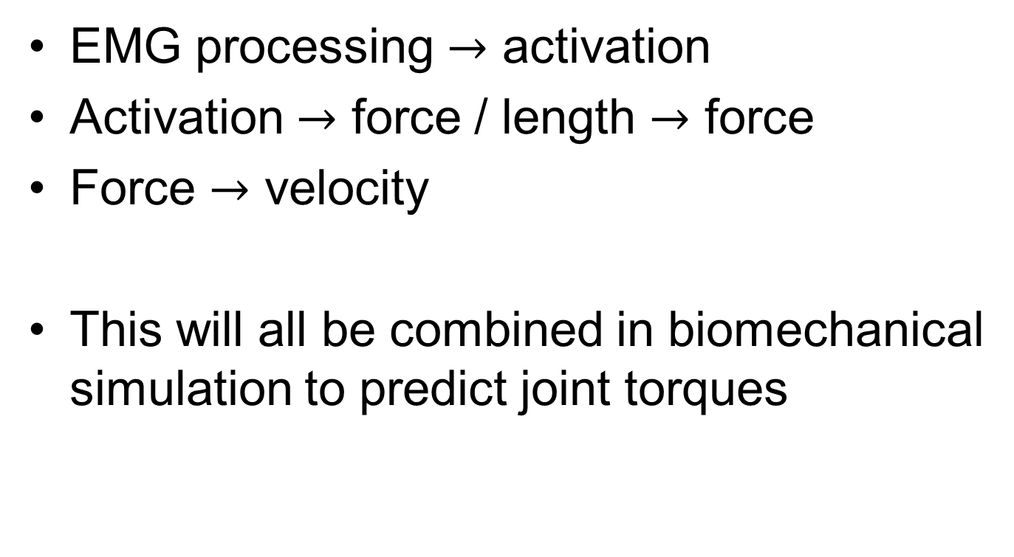
Summary: activation to force
EMG processing $→$ activation
Activation $→$ force / length $→$ force
Force $→$ velocity
This will all be combined in biomechanical simulation to predict joint torques

Slide 35
Part 4
Tendons

Slide 36
Forward model of the motor system
Muscle force is redirected and filtered by tendons
Buchanan J Appl Biomechanics 2004 doi:10.1123/jab.20.4.367

Slide 37
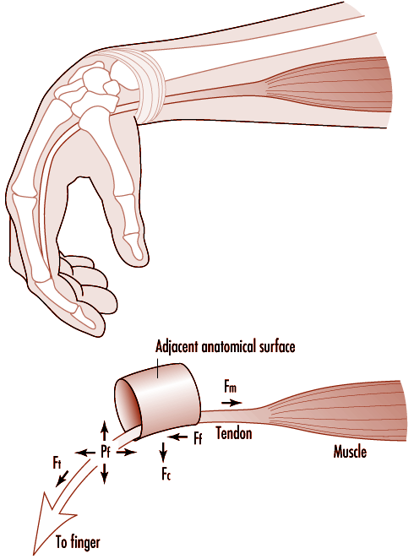
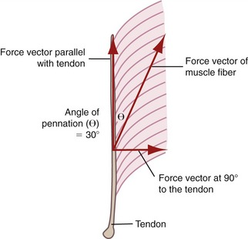
What tendons do
Tendons provide elasticity
Tendons redirect force

Slide 38
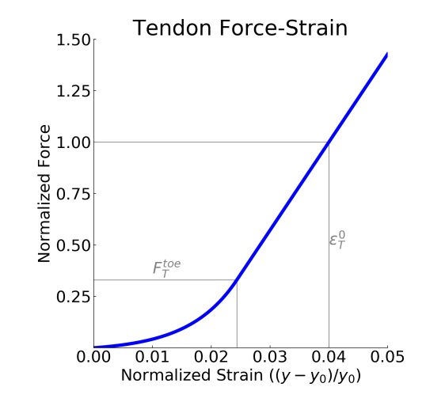
Modeling tendon behavior: non-linear strain
The tendon will apply force that depends on its length.
This dependence is non-linear.
Small changes in tendon length cause substantial force
Exponential toe
Linear range
Stretch is a few percent

Slide 39
Modeling tendon behavior: non-linear strain
Exponential toe
Linear range
Stretch is a few percent

Slide 40
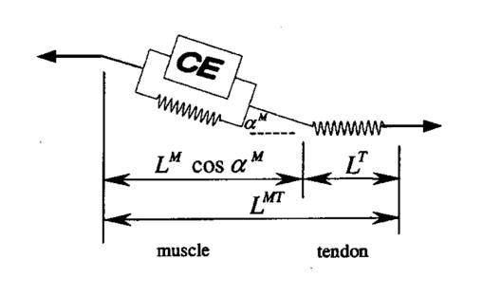
Pennation angle affects for transmission

Slide 41
Part 5
Hill-type muscle model

Slide 42
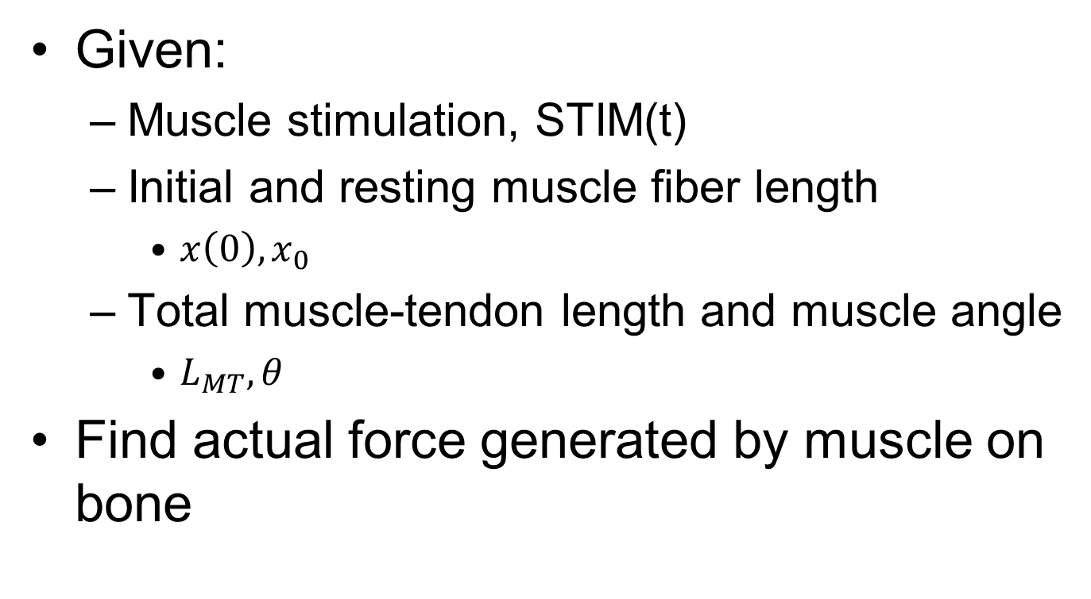
What does a Hill-type model do?
Given:
Muscle stimulation, STIM(t)
Initial and resting muscle fiber length
$x\left(0\right), x_{0}$
Total muscle-tendon length and muscle angle
$L_{MT},θ$
Find actual force generated by muscle on bone

Slide 43
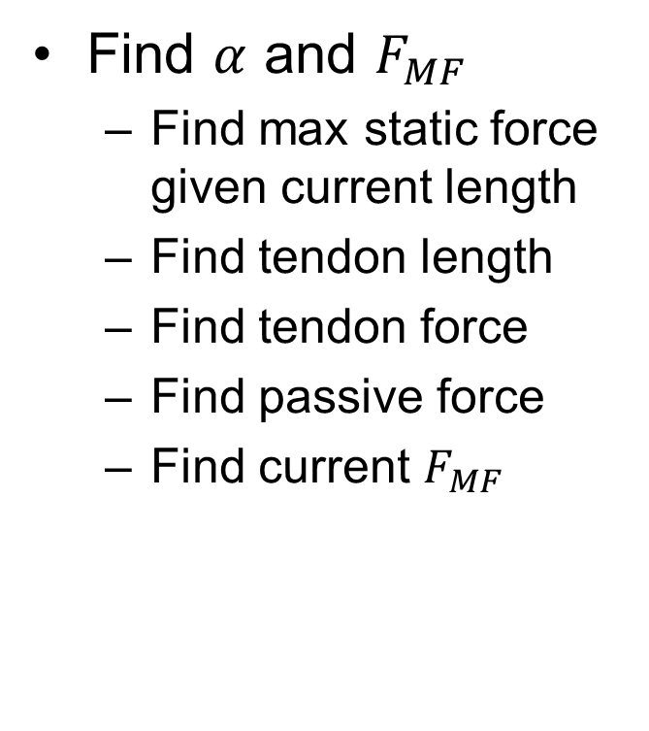
Step 1 contractile element: activation to force
Find $α$ and $F_{MF}$
Find max static force given current length
Find tendon length
Find tendon force
Find passive force
Find current $F_{MF}$

Slide 44
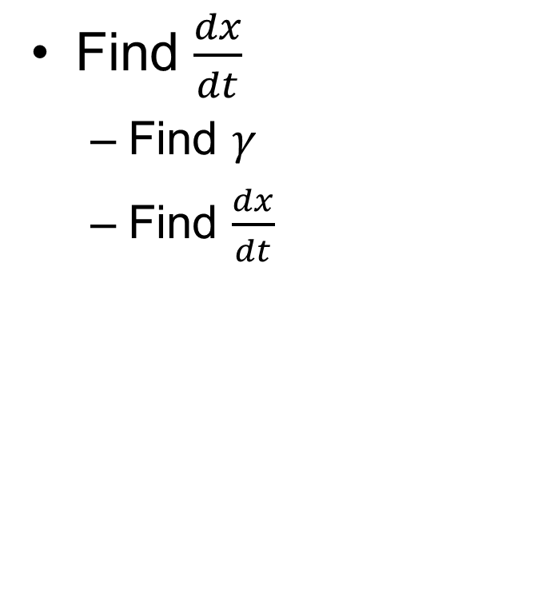
Step 2 series elastic element: tendon behavior
Find $\frac{dx}{dt}$
Find $γ$
Find $\frac{dx}{dt}$

Slide 45

Step 3 parallel elastic element: passive tissue
Use $\frac{dx}{dt}$ to update
$x$
$L_{MT}$
And then jump back to step 1

Slide 46
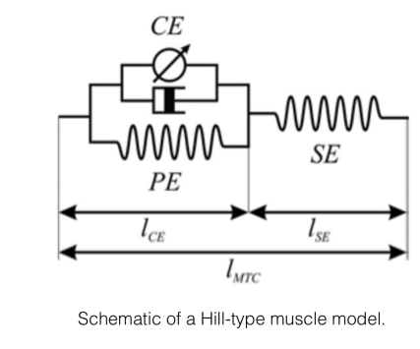
The Hill-type muscle model
First proposed by Hill in 1938
Many alternatives since
Captures basic phenomenology of muscle tendon system
Although fails to capture many experimental findings

Slide 47
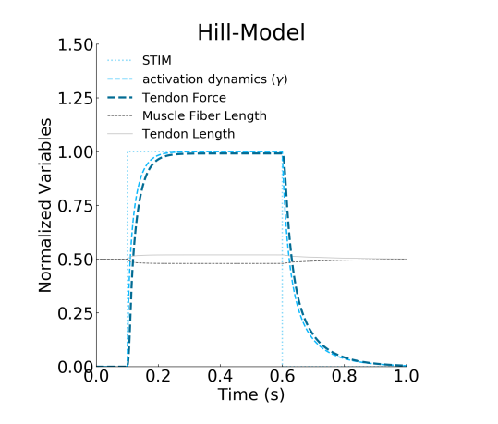
Hill results: stimulation

Slide 48
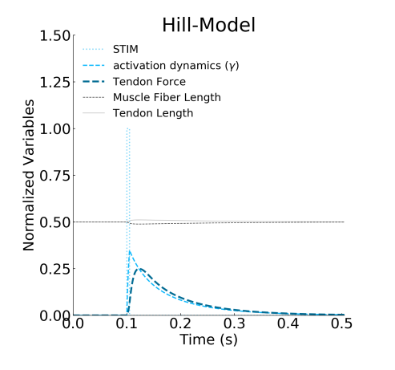
Hill results: pulse

Slide 49
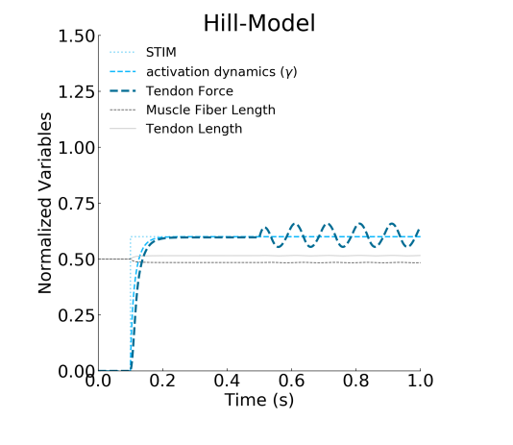
Muscle oscillations

Slide 50
Part 6
From muscle activation to movement

Slide 51
Forward model of the motor system
Motion, movement and biomechanics over the next two weeks
For understanding muscles, use a very simple one dimensional model
Buchanan J Appl Biomechanics 2004 doi:10.1123/jab.20.4.367

Slide 52
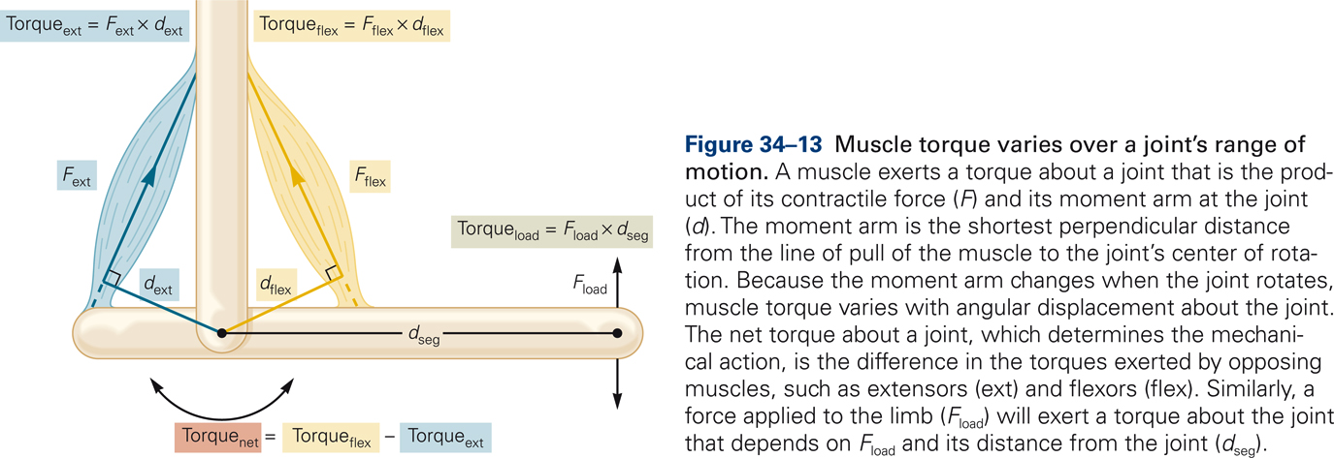

Slide 53
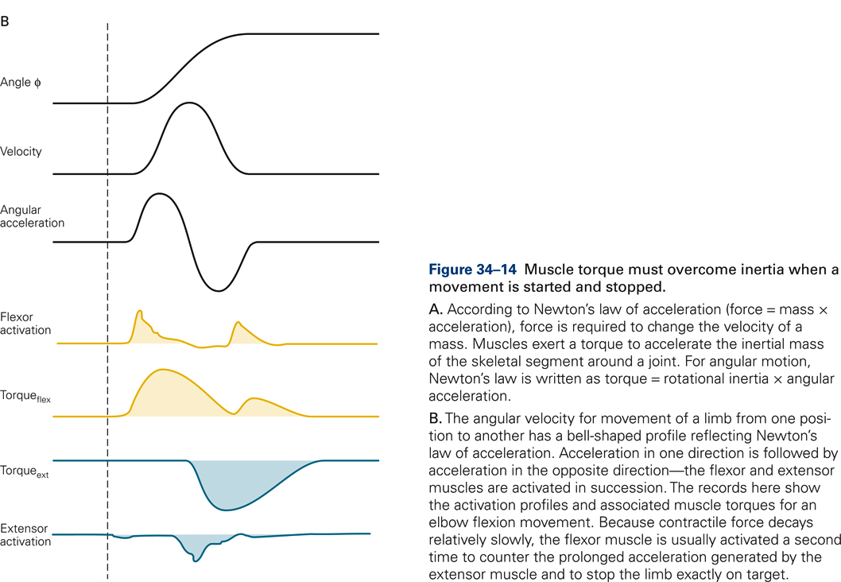
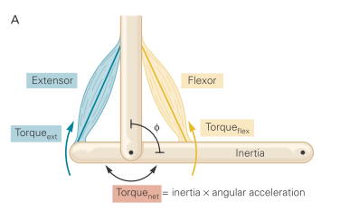

Slide 54
Summary
From muscle activation to force generation
We now have a full forward model of muscle behavior
EMG
Activation
Muscle force
Force output
Length
Elasticity
Velocity
Pennation
Muscle
Tendon

Slide 55

The Hill-type muscle model
A simplified model for the in-class assignment
Contractile element (the muscle)
Series elastic element (the tendon)
Activation dynamics (filtered response to stimulation)

Slide 56
What can a Hill-type model do?
When simulated with different
Inputs
Muscle lengths
This model can produce the following behaviors:
Twitch response
Tonic response
Graded response
Sensitivity to timing and length

Slide 57
In-class: from stimulation to force
We provide the muscle model
Try to match a target force trace by manipulating:
Stimulation timing and amplitude
Muscle-tendon unit length
Submit the handout notebook with your part filled in
Extra extra-credit to the best answers

Slide 58
It's Kahoot Time!
Gather your devices and get ready!
Let's see who’s on top of the material!
Notes:
This slide signals the transition to the Kahoot quiz. Encourage participants to grab their devices and prepare to join the quiz. Highlight the excitement of competition, and remind them that there are fun prizes to be won. Create an engaging atmosphere as everyone gets ready to show their knowledge!

Slide 59

In class notebook
Open in class exercise in Google colab

